Slide 1
CA2 UNSUPERVISED
Haaris Sulaiman P2112815

Slide 2
PREDICTION TASK

Slide 3
What is the task?
As a HR manager, you want to understand your employees so that appropriate direction can be given to the management to satisfy and retain the employees.

Slide 4
DATA EXPLORATION & CLEANING

Slide 5
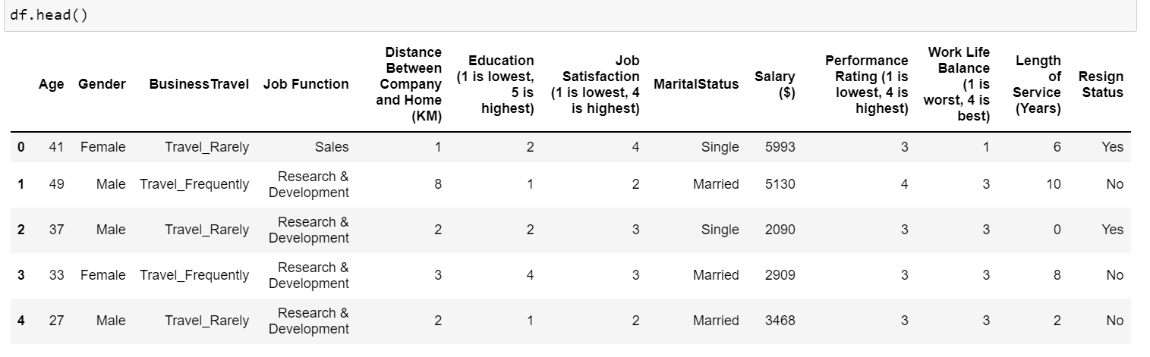
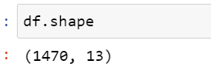
There are 1470 rows and 13 columns of data in this dataset

Slide 6
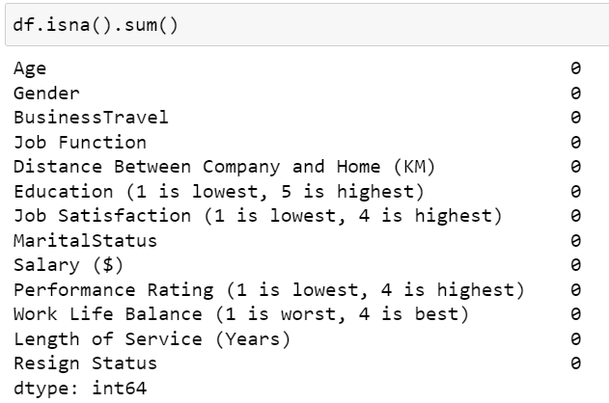
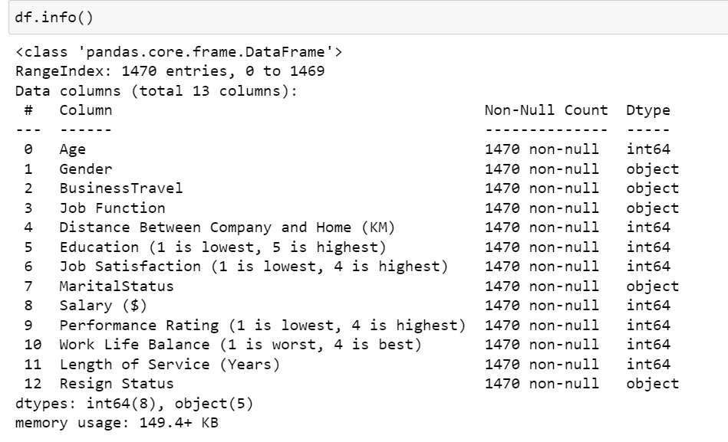
There are no null rows in this dataset and thus there are no missing values to impute in this dataset.

Slide 7
EXPLORY DATA ANALYSIS

Slide 8
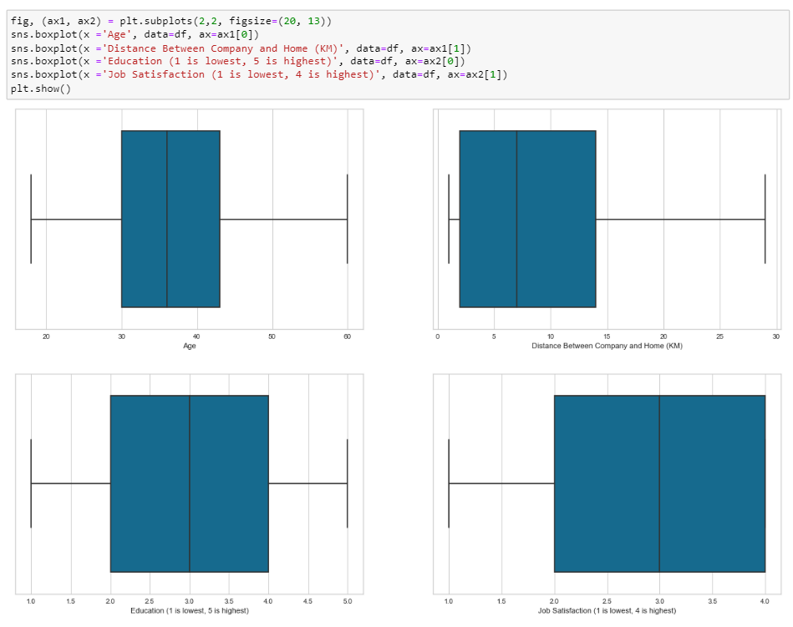

Slide 9
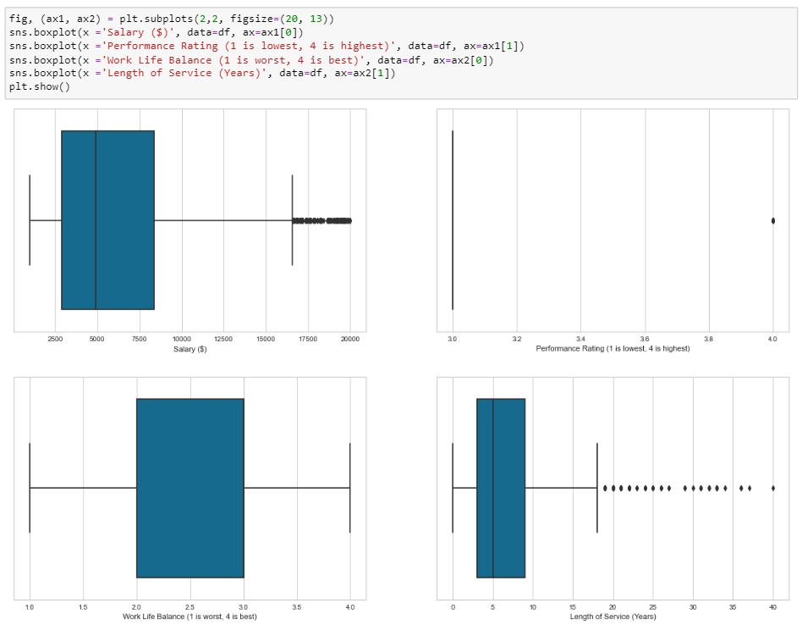

Slide 10
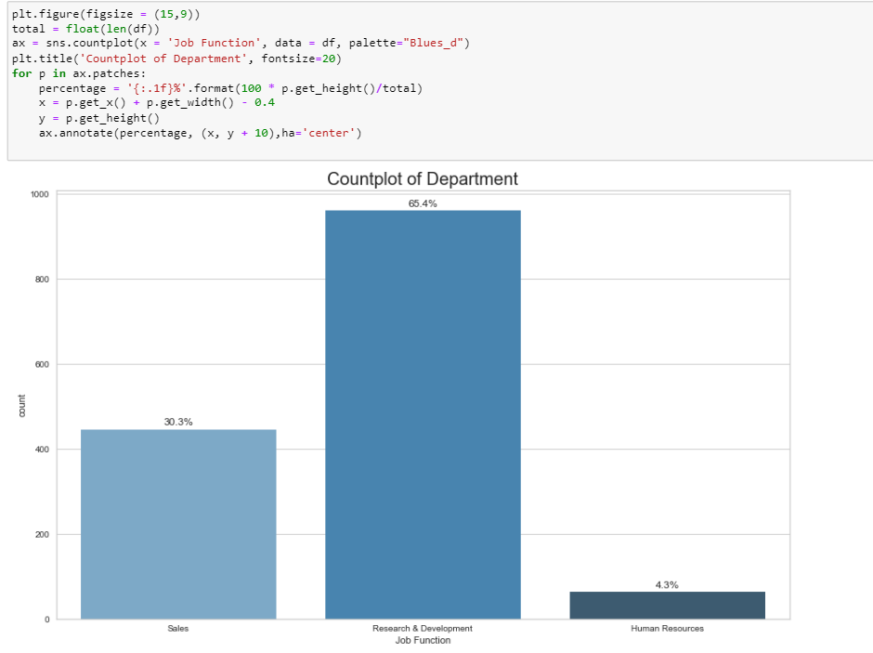

Slide 11
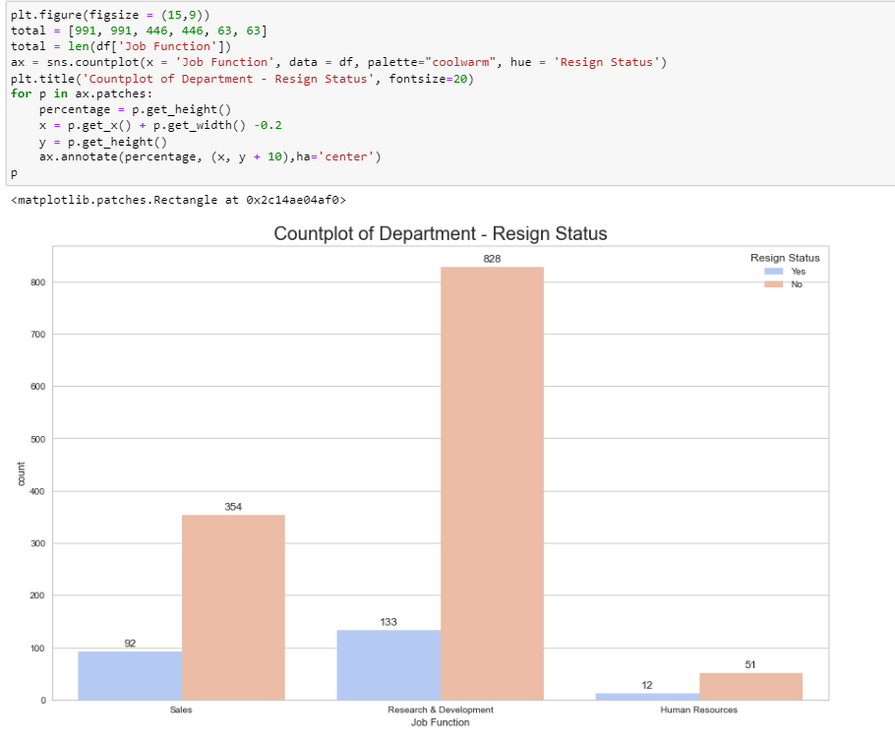

Slide 12
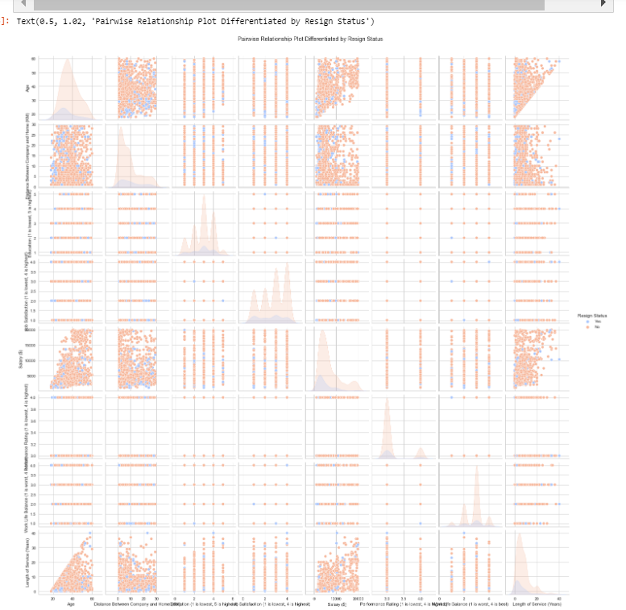

Slide 13
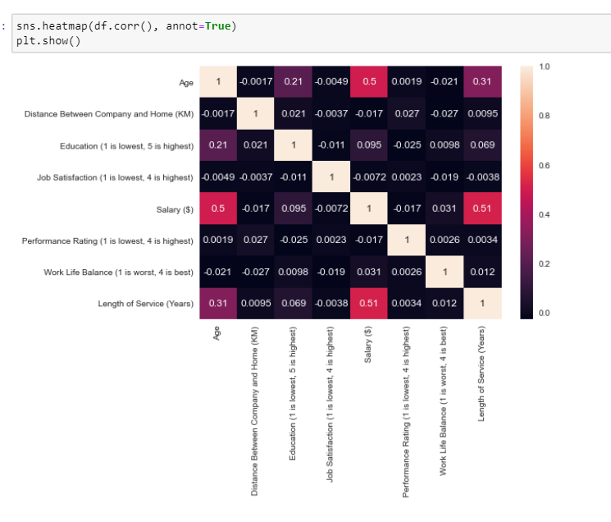

Slide 14
FEATURE ENCODING

Slide 15
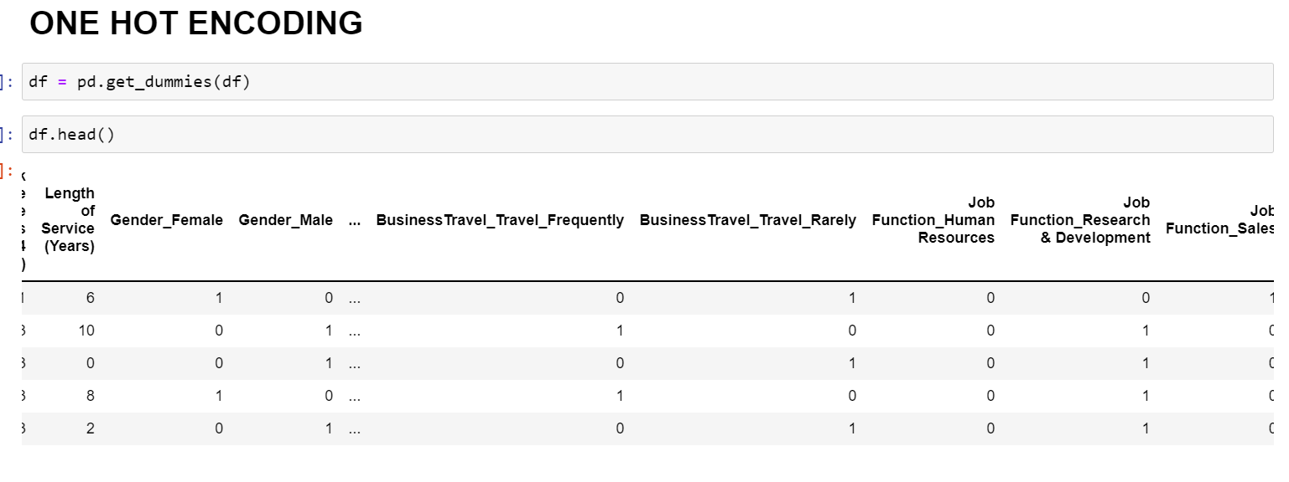

Slide 16
FEATURE SCALING

Slide 17
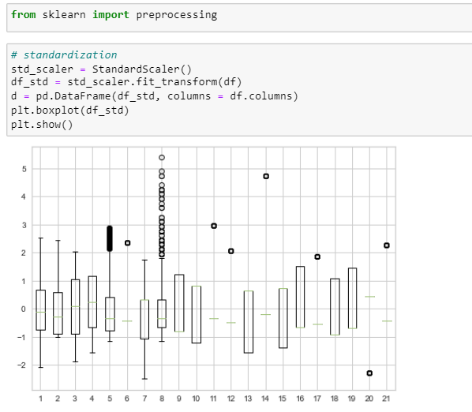

Slide 18
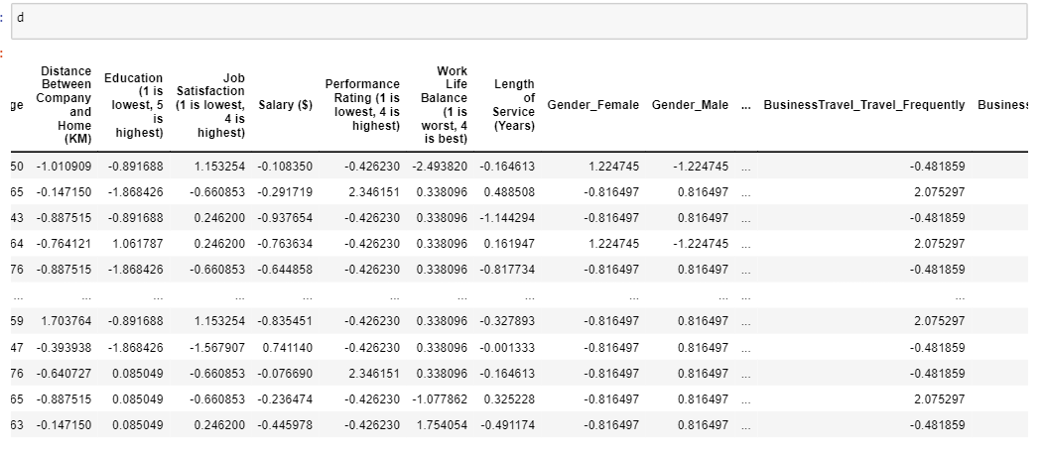

Slide 19
DIMENSION REDUCTION

Slide 20
PCA

Slide 21
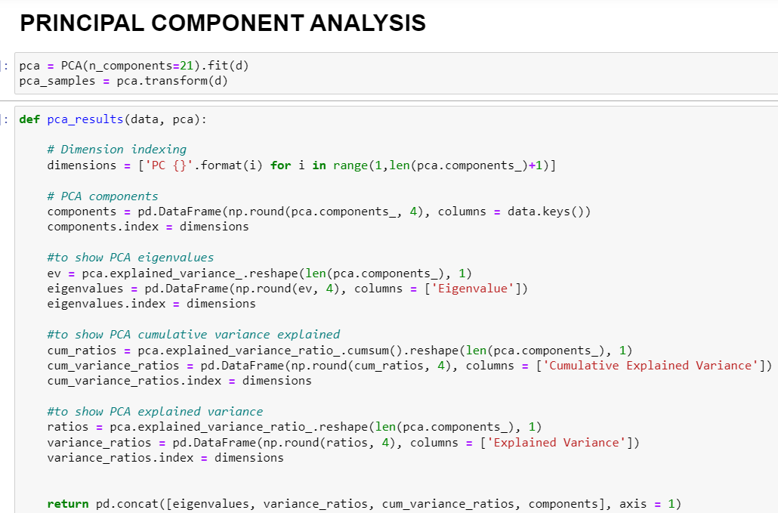

Slide 22
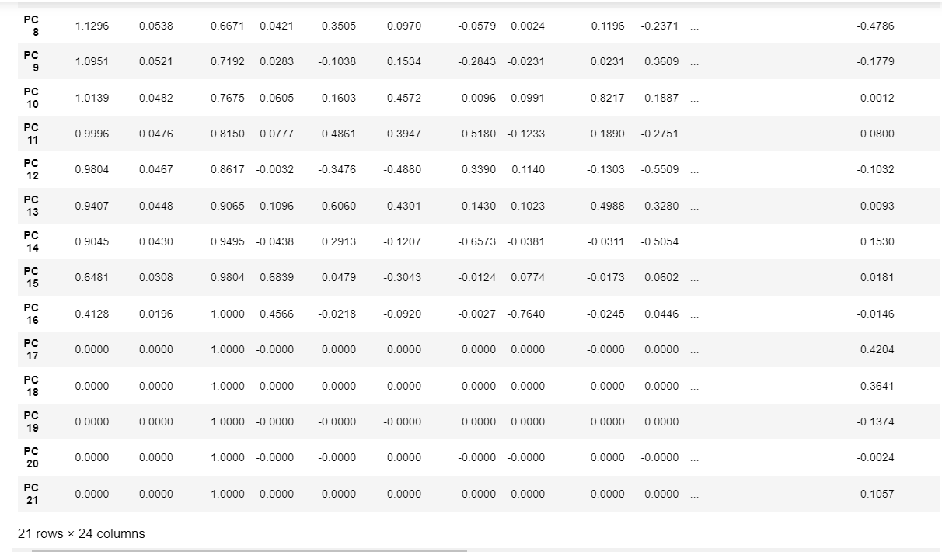

Slide 23
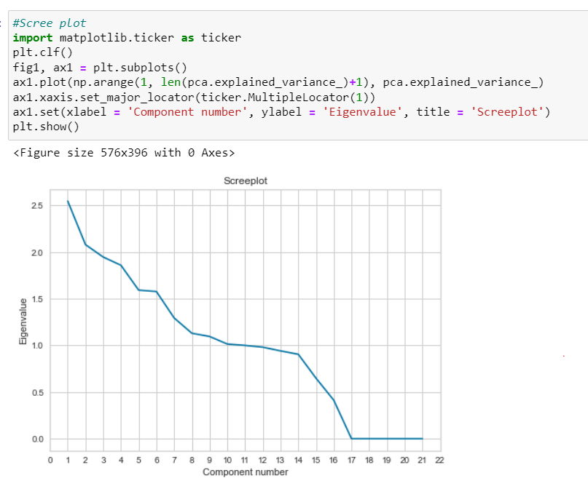
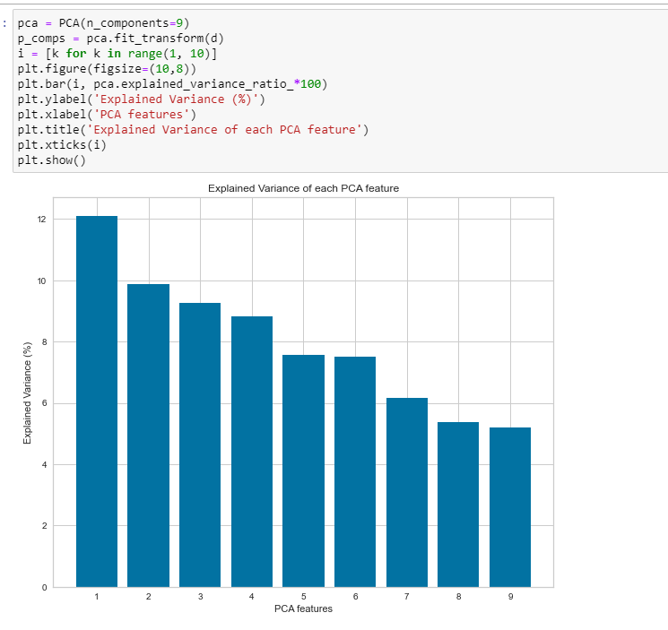

Slide 24
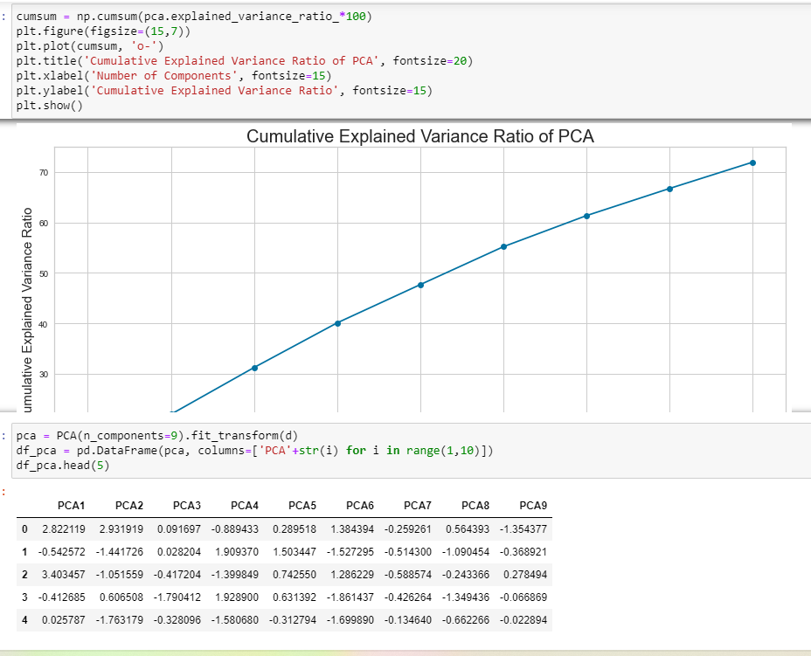

Slide 25
t-SNE

Slide 26
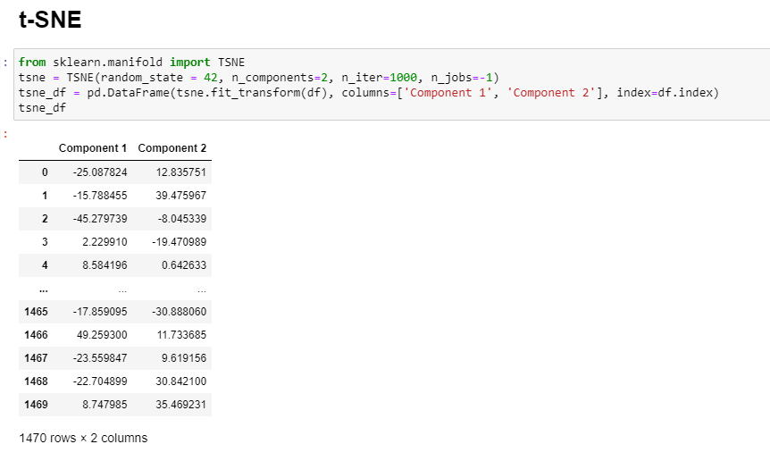

Slide 27
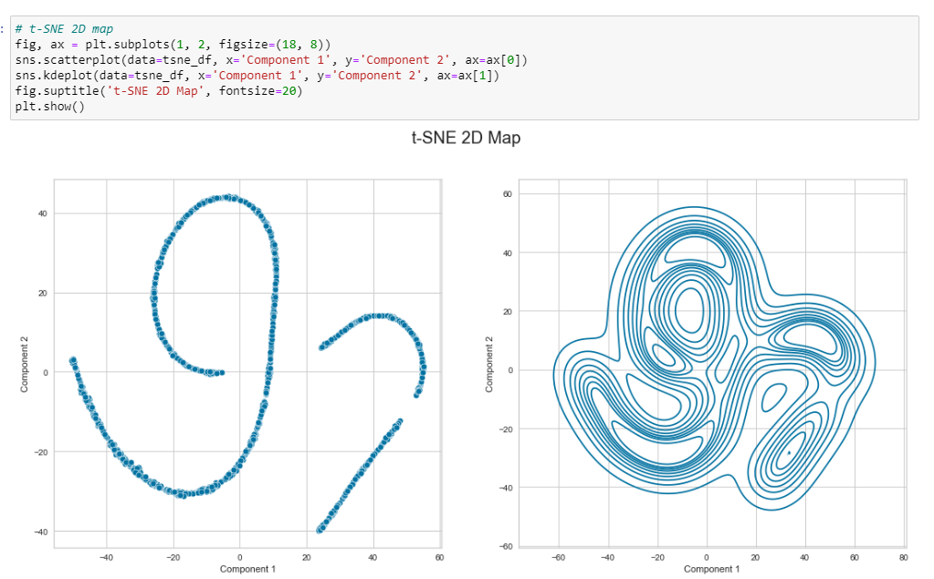

Slide 28
CLUSTERING MODELS

Slide 29
K-MEANS CLUSTERING

Slide 30
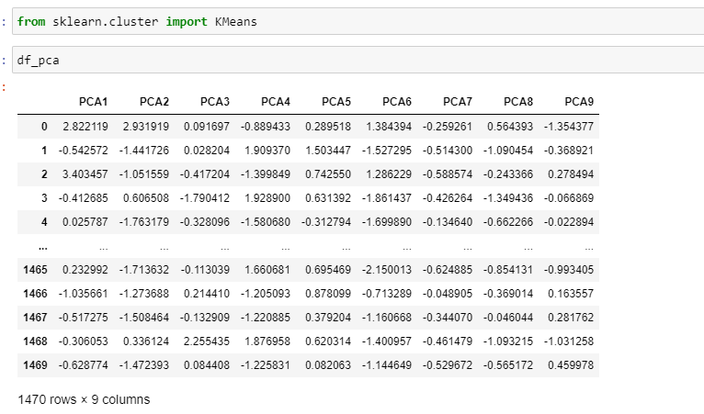

Slide 31
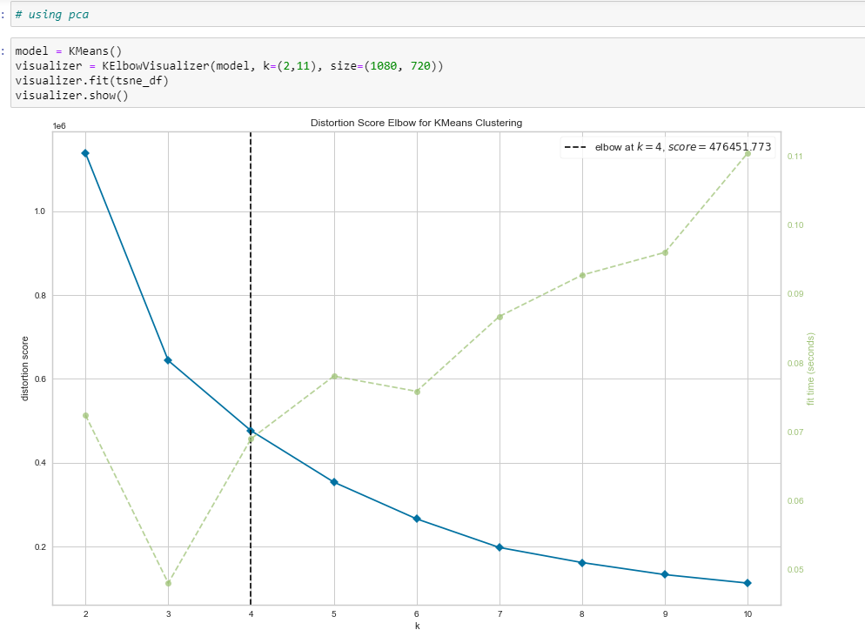
Using t-SNE

Slide 32
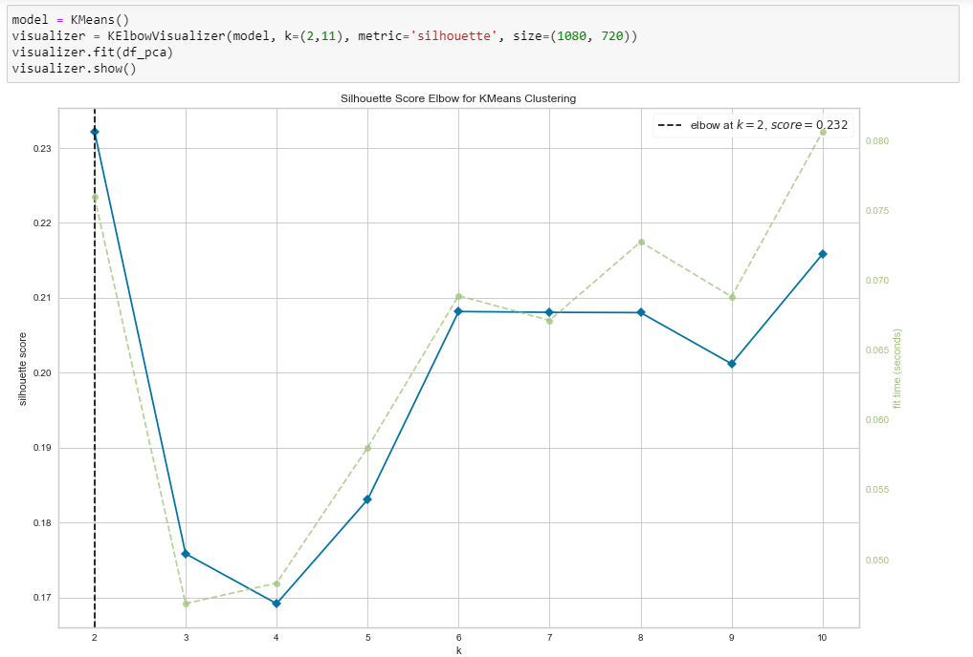
Using PCA

Slide 33
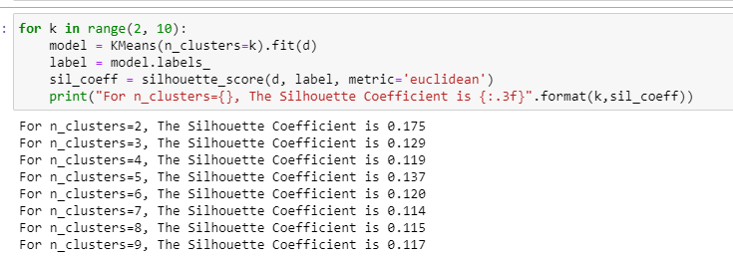
Silhouette scores

Slide 34
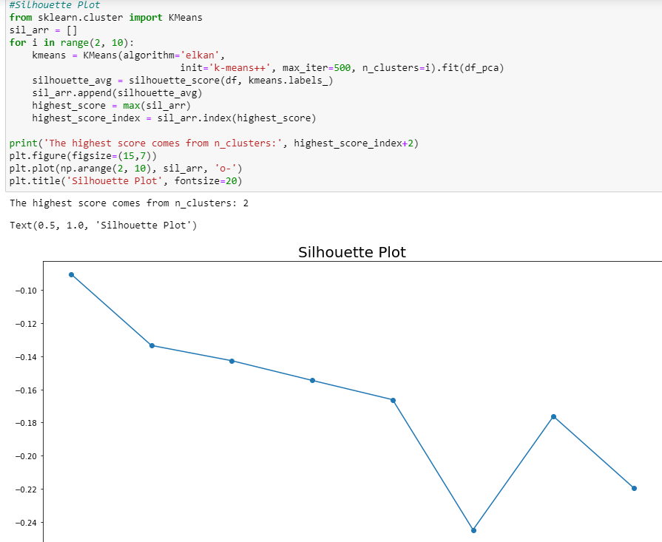
Silhouette Plot

Slide 35
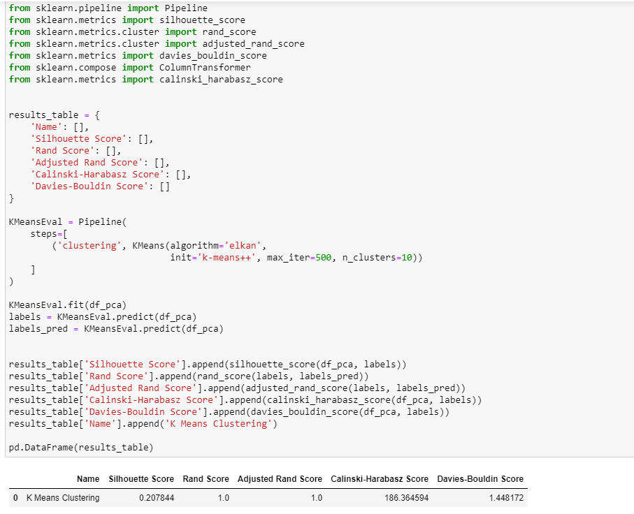
Pipeline

Slide 36
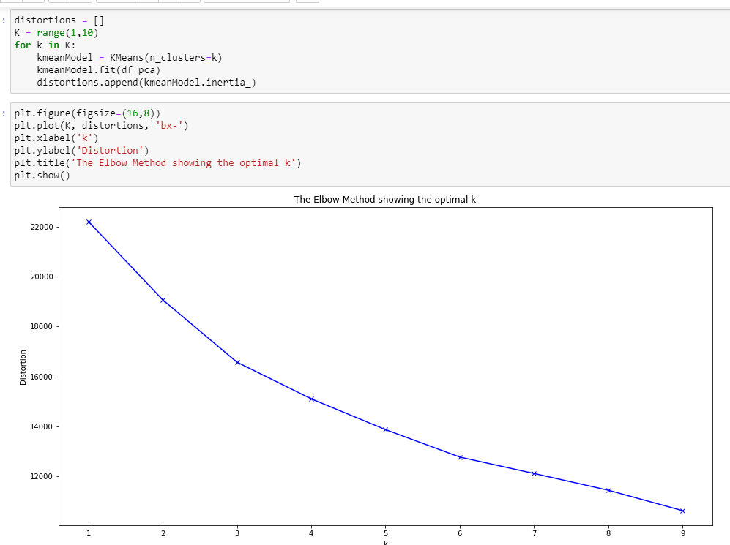
Elbow method

Slide 37
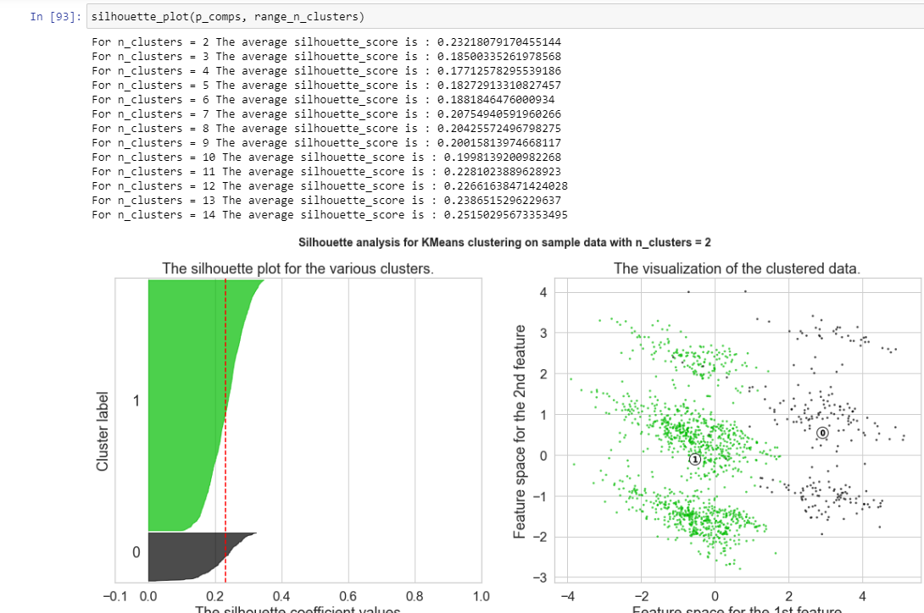
Silhouette Plot

Slide 38
HIERARCHICAL CLUSTERING

Slide 39
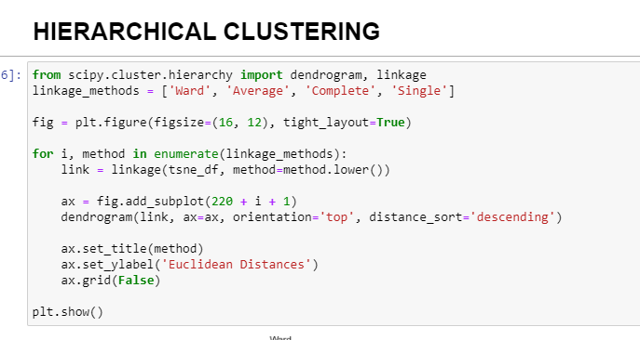

Slide 40
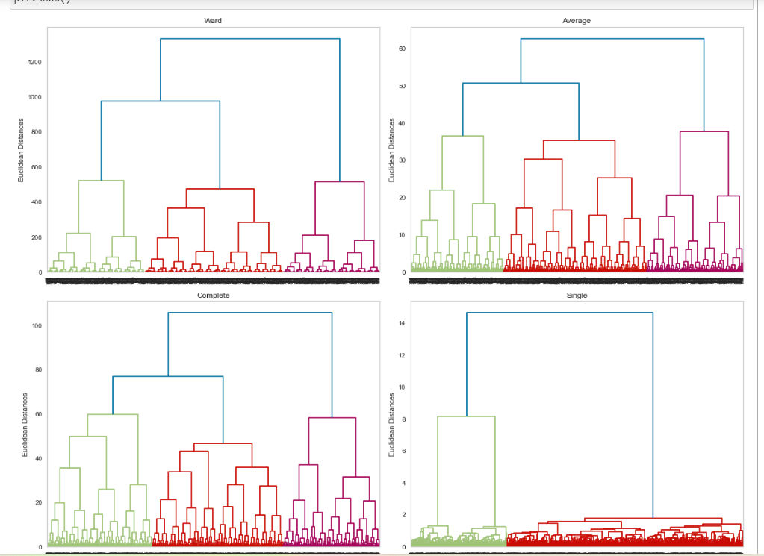

Slide 41
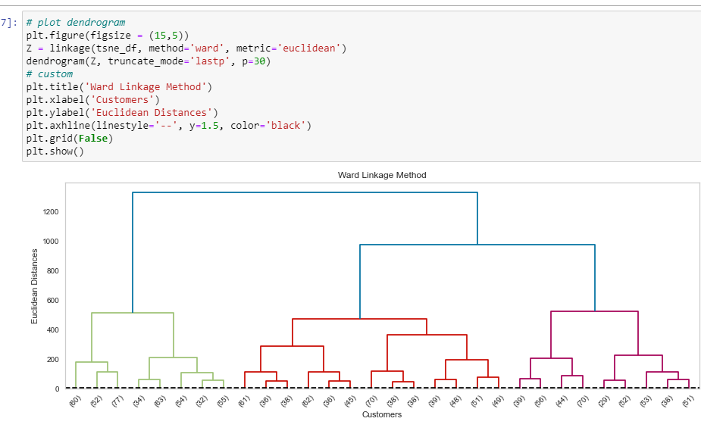

Slide 42
AGGLOMERATIVE CLUSTERING

Slide 43
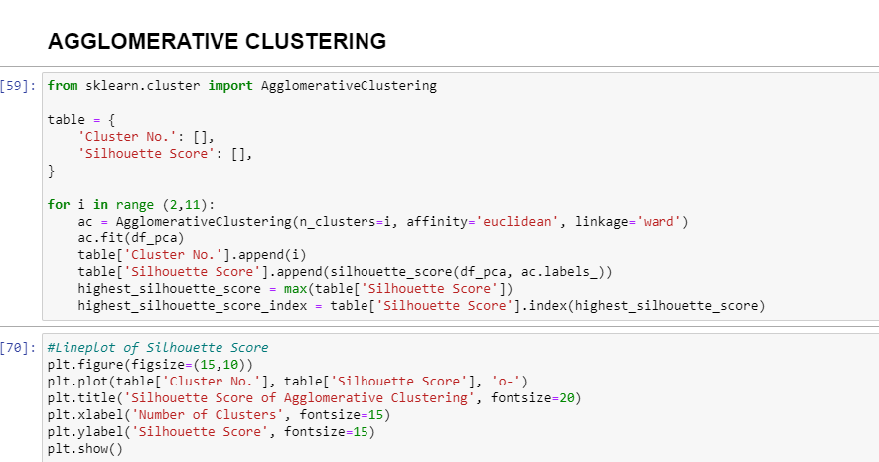

Slide 44
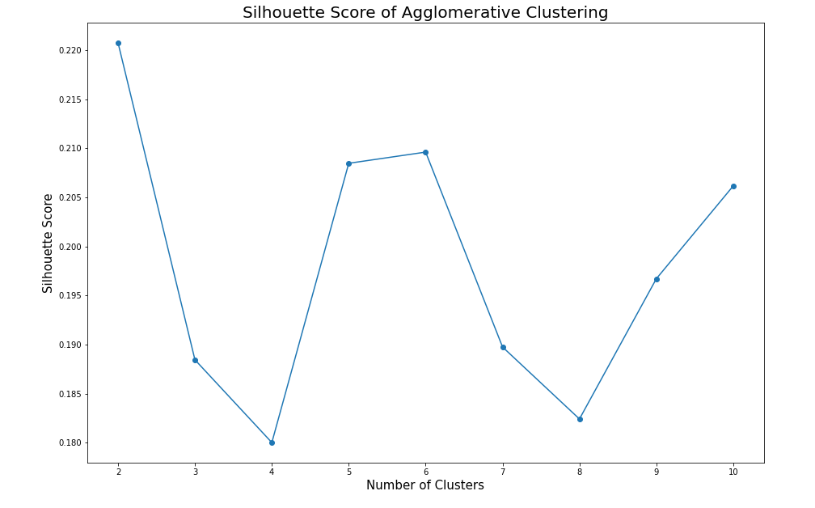

Slide 45
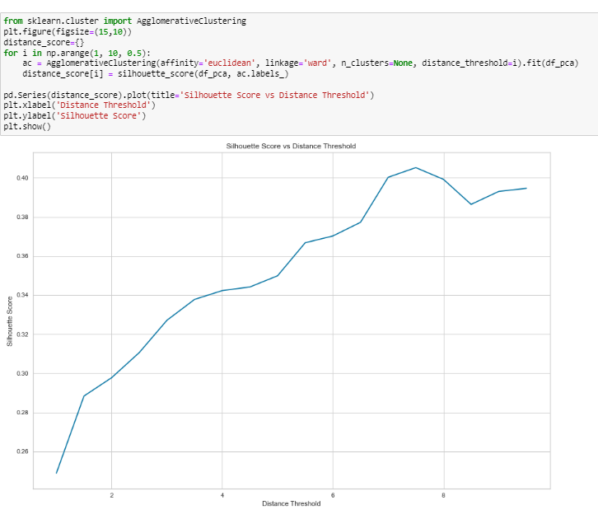
Using PCA

Slide 46
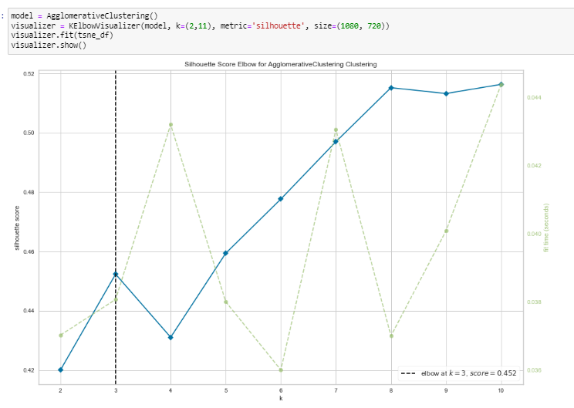
Using t-SNE

Slide 47
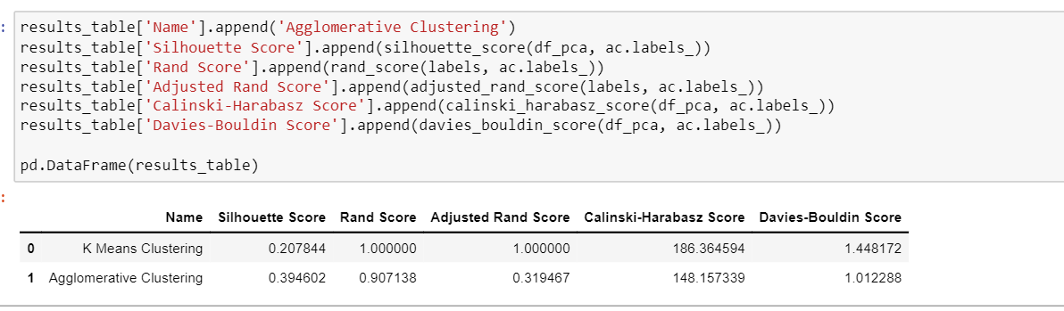

Slide 48
OBTAINING THE CLUSTERS

Slide 49
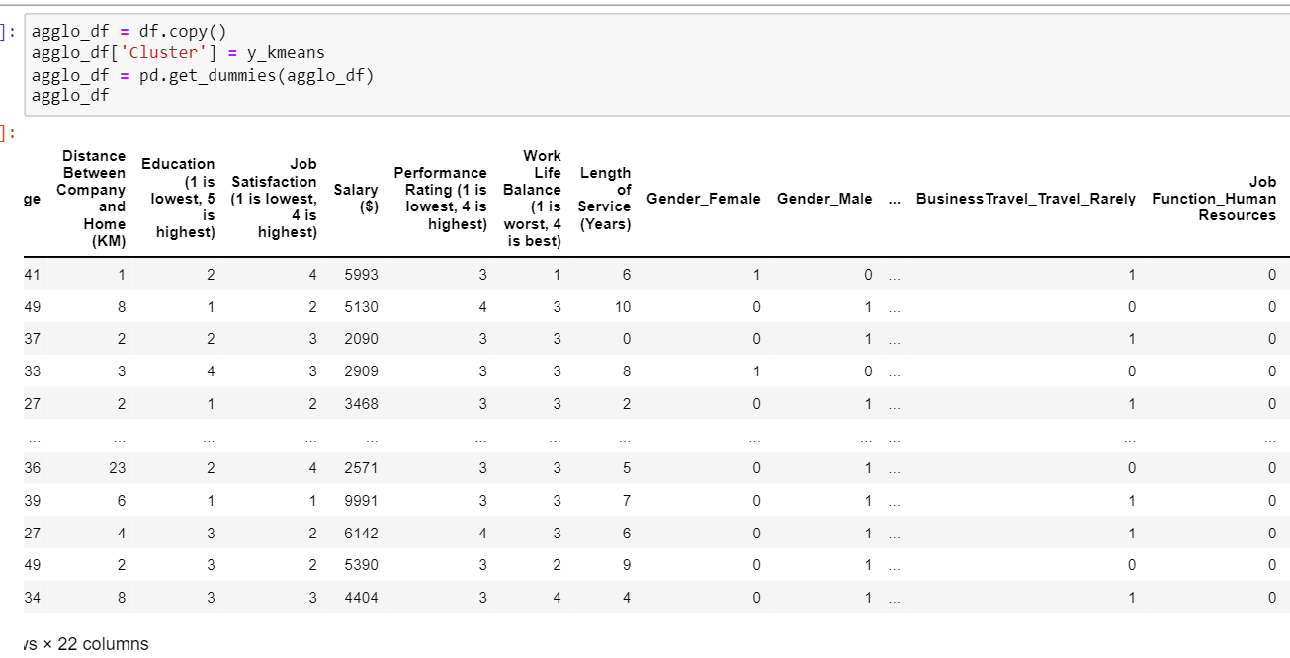

Slide 50
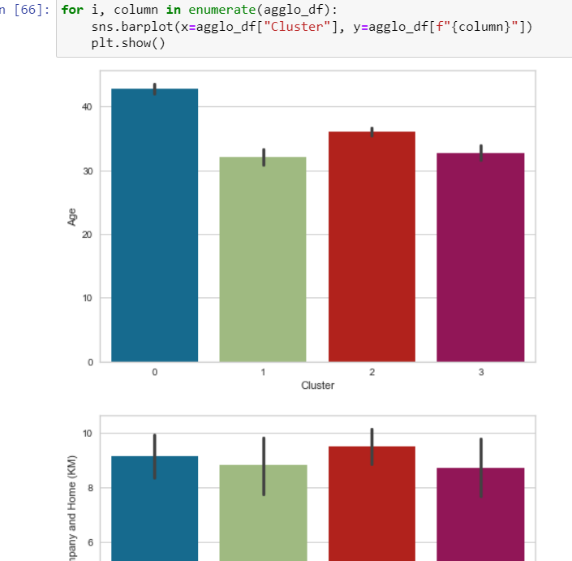

Slide 51
We have successfully achieved employee segmentation and we have 4 employee clusters. They have the following characteristics:
Rarely go for business travels
In Research & Development
Are married

Slide 52
To identify employees who are vulnerable, we look at the “Resign Status_Yes”. Cluster 1 makes up the bulk of employees that resign and their characteristics are:
In Research & Development
Low salary
To maintain these employees, HR should consider increasing the salary of those who are vulnerable to resigning.

